Slide 1

British Airways
British Airways Customer Review Analysis
Telephone
Address
Website
February, 2025
+123-456-7890
123 Anywhere St., Any City,
ST 12345
www.reallygreatsite.com

Slide 2

EXECUTIVE SUMMARY
The analysis is based on 1,000 customer reviews of British Airways, processed using advanced natural language processing techniques including aspect-based sentiment analysis and zero-shot classification.

Slide 3
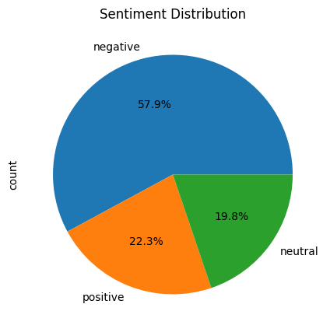
KEY VISUALIZATIONS
British Airways
OVERALL SENTIMENT DISTRIBUTION
19%
Neutral reviews
57% | Negative reviews
22% | Positive reviews

Slide 4

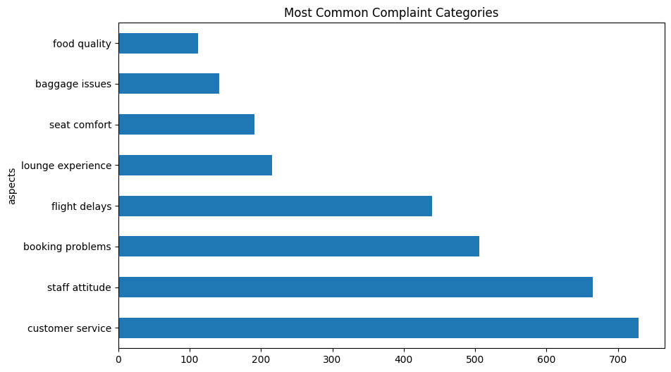
Top Customer Concerns
Based on the aspect frequency analysis, the most commonly mentioned categories,

Slide 5
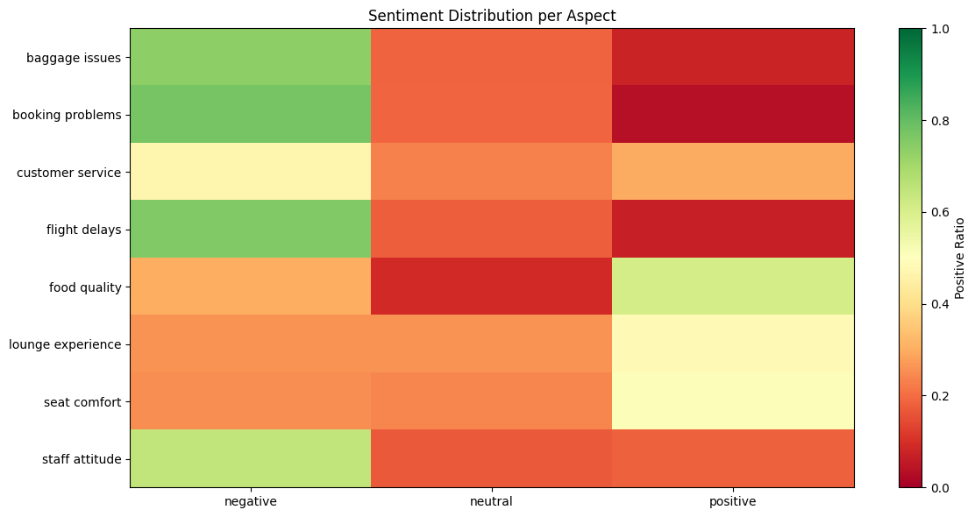
ASPECT-SENTIMENT ANALYSIS
British Airways

Slide 6

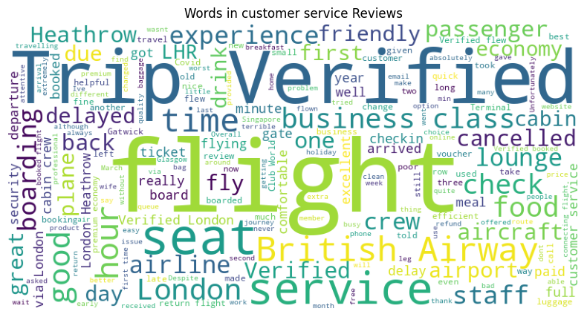
WORD CLOUD
British Airways

Slide 7
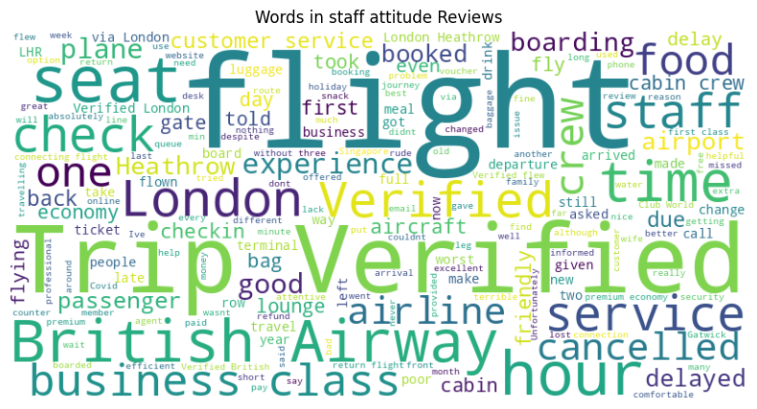
WORD CLOUD
British Airways

Slide 8
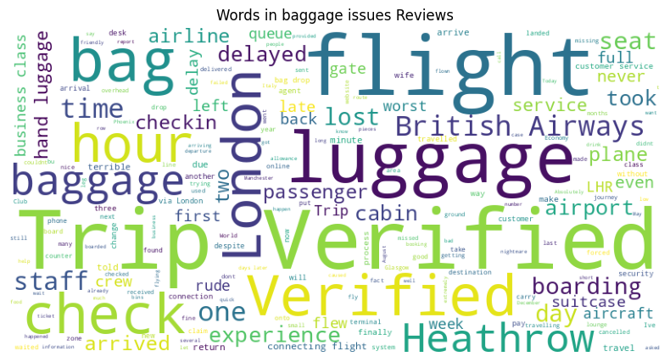
WORD CLOUD
British Airways

Slide 9


01
Customer Service
The most frequently mentioned aspect in reviews
Strong correlation with negative sentiment
Common themes from Word Cloud.
DETAILED ASPECT ANALYSIS
02
Baggage Issues
Second most discussed concern
Predominantly negative sentiment
Key issues include lost luggage and handling problems
03
Flight Operations
Significant mentions of delays
Mixed sentiment distribution but leaning negative
Impact on customer satisfaction is substantial
04
Staff and Service Quality
Staff attitude shows a more balanced sentiment distribution
Food quality receives less mention but shows room for improvement
British Airways

Slide 10



RECOMMENDATIONS
British Airways
Priority Areas for Improvement
Service Enhancement
Customer Experience
Invest in staff training for consistent service delivery
Upgrade booking systems to reduce technical issues
Review and enhance food service quality
Implement proactive communication during delays
Enhance lounge services as a positive differentiator
Improve seat comfort based on feedback
Enhance baggage handling systems and tracking
Streamline customer service response protocols
Improve flight punctuality and delay communication

Slide 11

SUGGESTED IMPLEMENTATION TIMELINE
Short-term (0-6 months):
Customer service response time improvement
Staff training programs
Communication protocol enhancement
Medium-term (6-12 months):
Baggage handling system upgrades
Booking system improvements
Food service quality enhancement
Long-term (12+ months):
Fleet comfort upgrades
Lounge renovation and expansion
Complete digital transformation of customer service

Slide 12
MONITORING METRICS
British Airways
Customer Satisfaction:
Overall sentiment score
Aspect-specific satisfaction rates
Net Promoter Score (NPS)
Operational Excellence:
Baggage handling success rate
Flight punctuality
Customer service response time
Service Quality:
Staff performance ratings
Food and beverage satisfaction
Lounge utilization and satisfaction

Slide 13
CONCLUSION
British Airways
The analysis reveals significant opportunities for British Airways to improve customer satisfaction through targeted interventions in key operational areas. Priority should be given to addressing customer service, baggage handling, and flight punctuality issues while maintaining and enhancing areas of relative strength such as lounge services.

Slide 14
British Airways
THANK YOU
FOR YOUR NICE ATTENTION
Telephone
Address
Website
February 2025
896547365
374837 jkdsjhsd
www.sjhdjsdhjs

